Slide 1


CITY OF SOUTH BEND
INCLUSIVE TECHNOLOGY RESOURCE CENTER
RESEARCH INSIGHTS // BUSINESS TEAM
UNIVERSITY OF NOTRE DAME // Design Research Practices
Sam Walker, Erin McGuire, Christopher Schilling
November 14, 2017

Slide 2
GOALS & CHALLENGES
RESEARCH GOALS
Identify the greatest challenges in workforce tech readiness
Explore the way employers currently assess tech readiness
Discover the tech needs of South Bend small business entrepreneurs
Investigate potential for internal workforce development
Tech skills businesses are looking for/want/currently have in their employees
Understand where tech roles open up for greater opportunity
PRIMARY CHALLENGES
Effectively merge the gap between job seekers and job providers by increasing job force readiness
GUIDING PRINCIPLES
Seeing employment from the hiring perspective
Notes:
Erin
emphasize merging gap

Slide 3
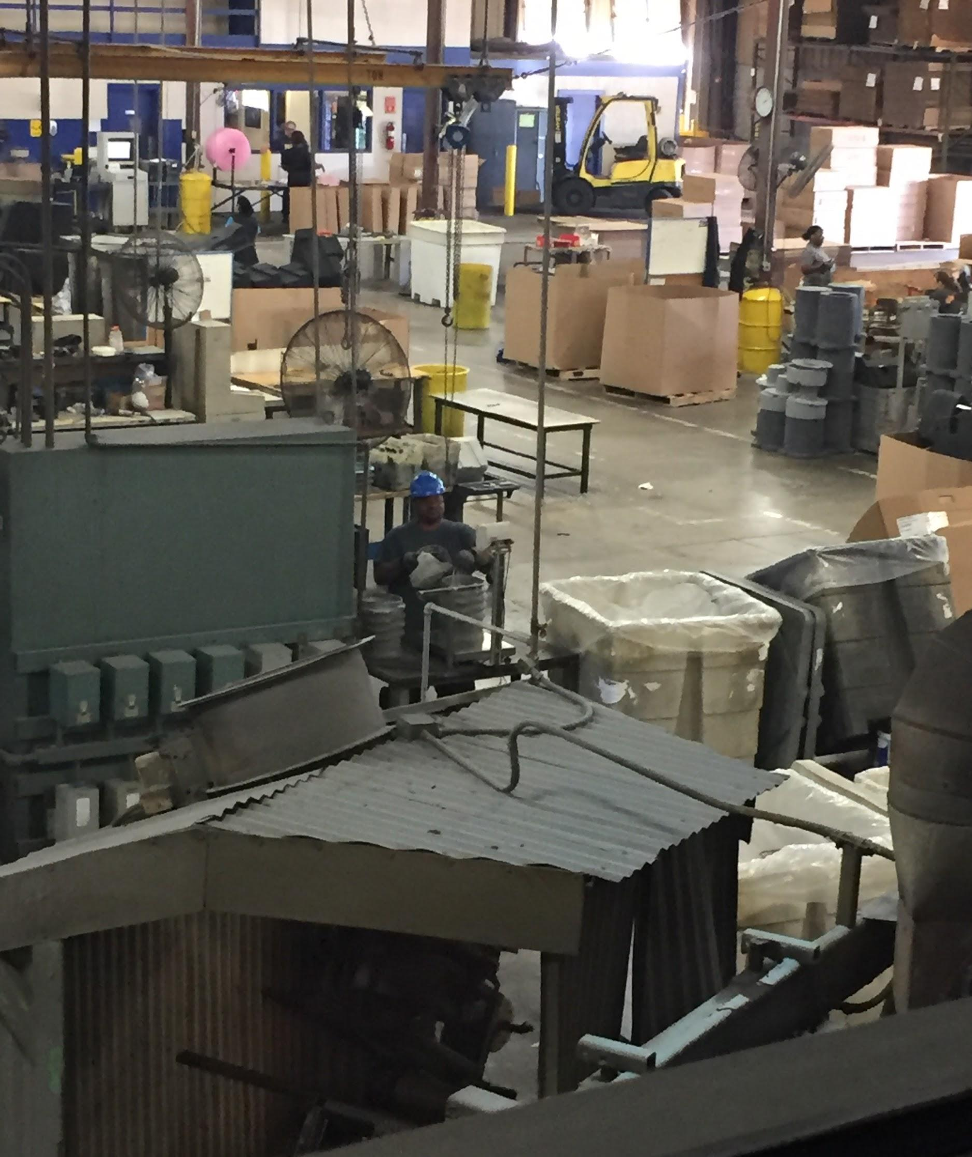
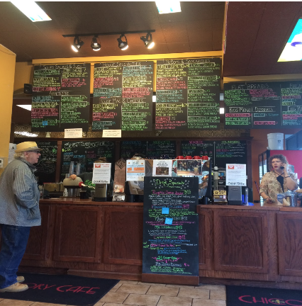
METHODOLOGY
Elkhart Plastics
Observed interactions between employees and technology at small to large businesses. Documented tech skills needed in routine activities throughout South Bend businesses.
Chicory Cafe
Notes:
Sam

Slide 4
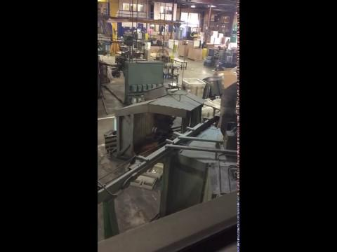
Bonnie, Elkhart Plastics, discussing the process being observed as employees monitor production
METHODOLOGY

Slide 5
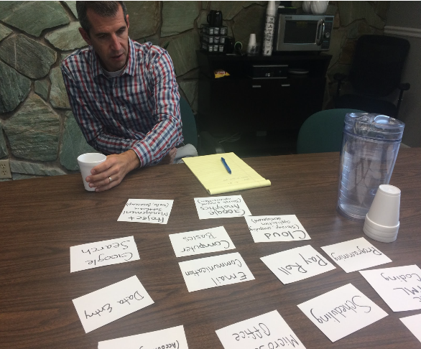

METHODOLOGY
James, SPI Industries, working through a card sort detailing the most important skillsets of potential and current employees. The sort included both soft and technical skills along with softwares most utilized in daily operations.
Lisa, ND HR, being interviewed about the recent ND Career Expo where applicants interviewed and were potentially given offers. This led to a discussion of “Crafting an Ideal Employee” with the aid of their existing job applications.

Slide 6
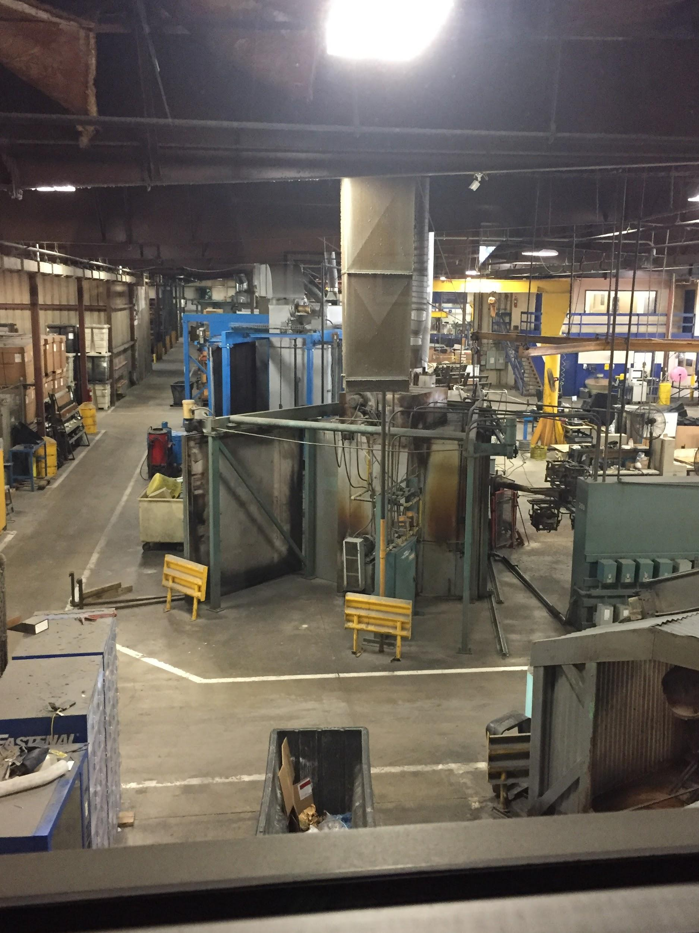
METHODOLOGY
Interview local companies across business sectors to gain a more comprehensive understanding of business tech needs.
SPI Industries
Elkhart Plastics Inc
HR Consultant for Aux Ops
HR Food Service / HR
Food Service employees
ND Career Fair
Chicory Cafe
Cops and Doughnuts
Notre Dame HR
Lippert Components HR
Thor Motor Coach HR at the HQ
enFocus
Beacon

Slide 7
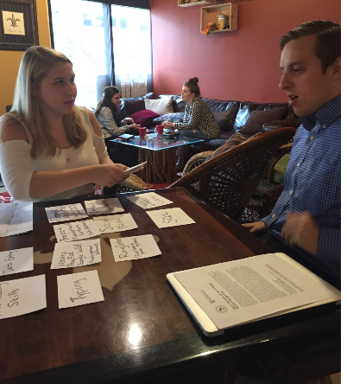

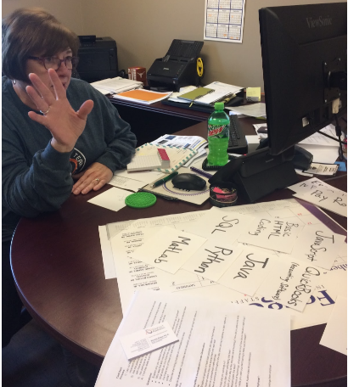
DATA COLLECTION
One on one ethnographic interviews
Patrick, Enfocus Sandra, ND Aux Operations Bonnie, Elkhart Plastics
Notes:
In person interviews with most companies, a few phone interviews with elkhart companies like lippert and thor motor coach.

Slide 8

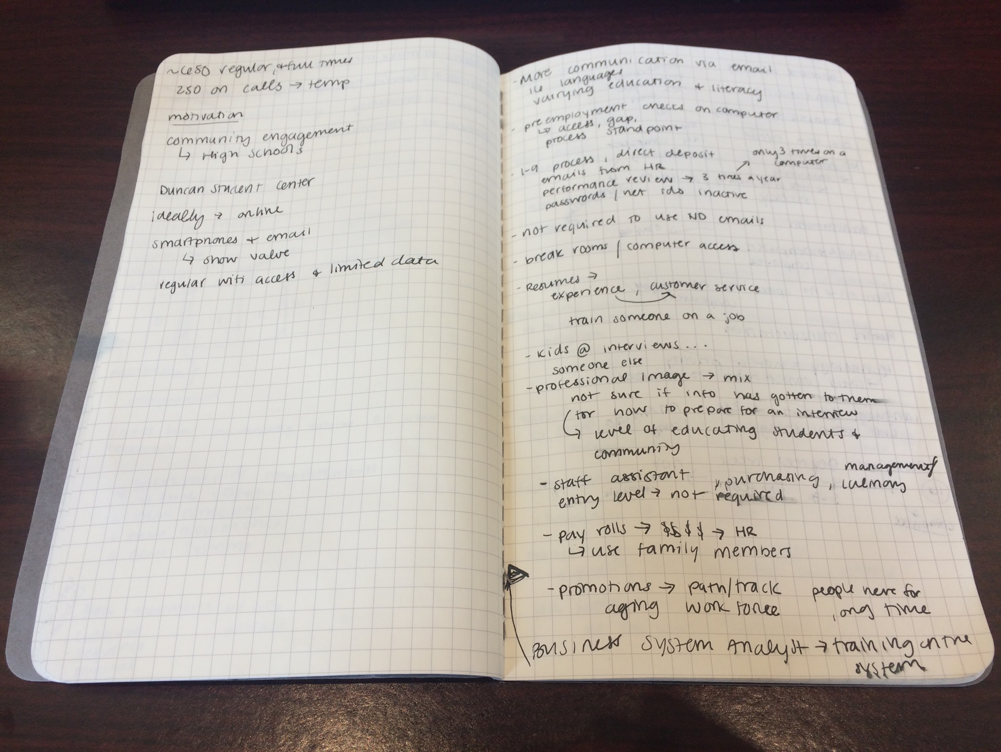
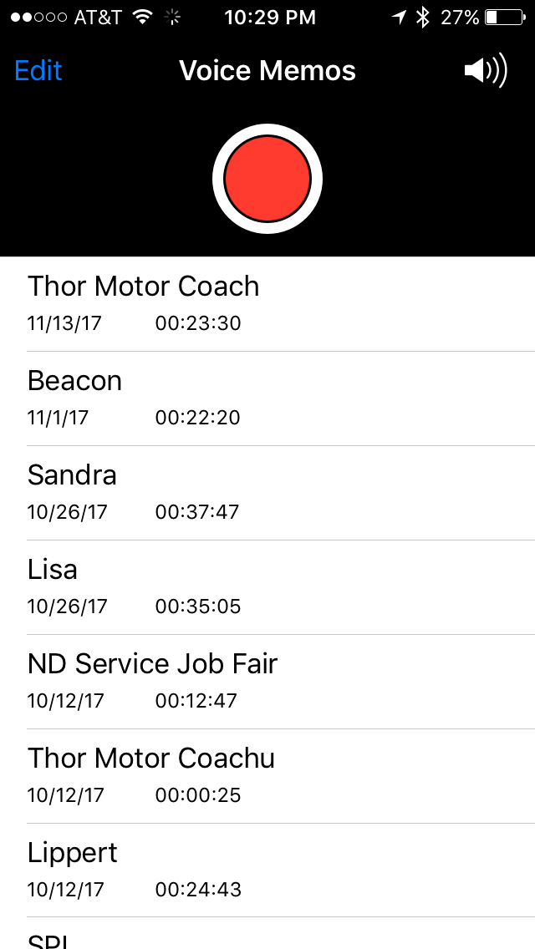
DATA COLLECTION
https://drive.google.com/file/d/1hsxR2DBQ_RA7HT94BEXVfHfwJXC1dimb/view

Slide 9
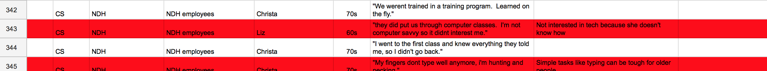
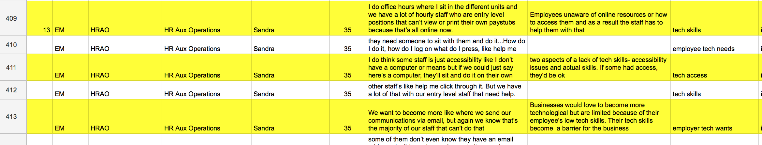
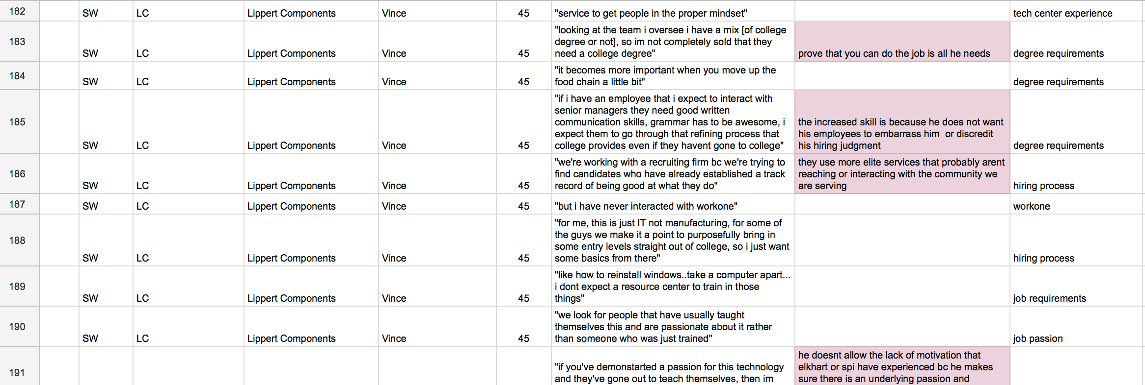
DATA COLLECTION

Slide 10
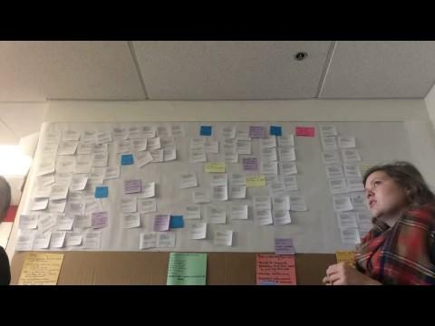
INSIGHT ORGANIZATION
Notes:
chris still

Slide 11
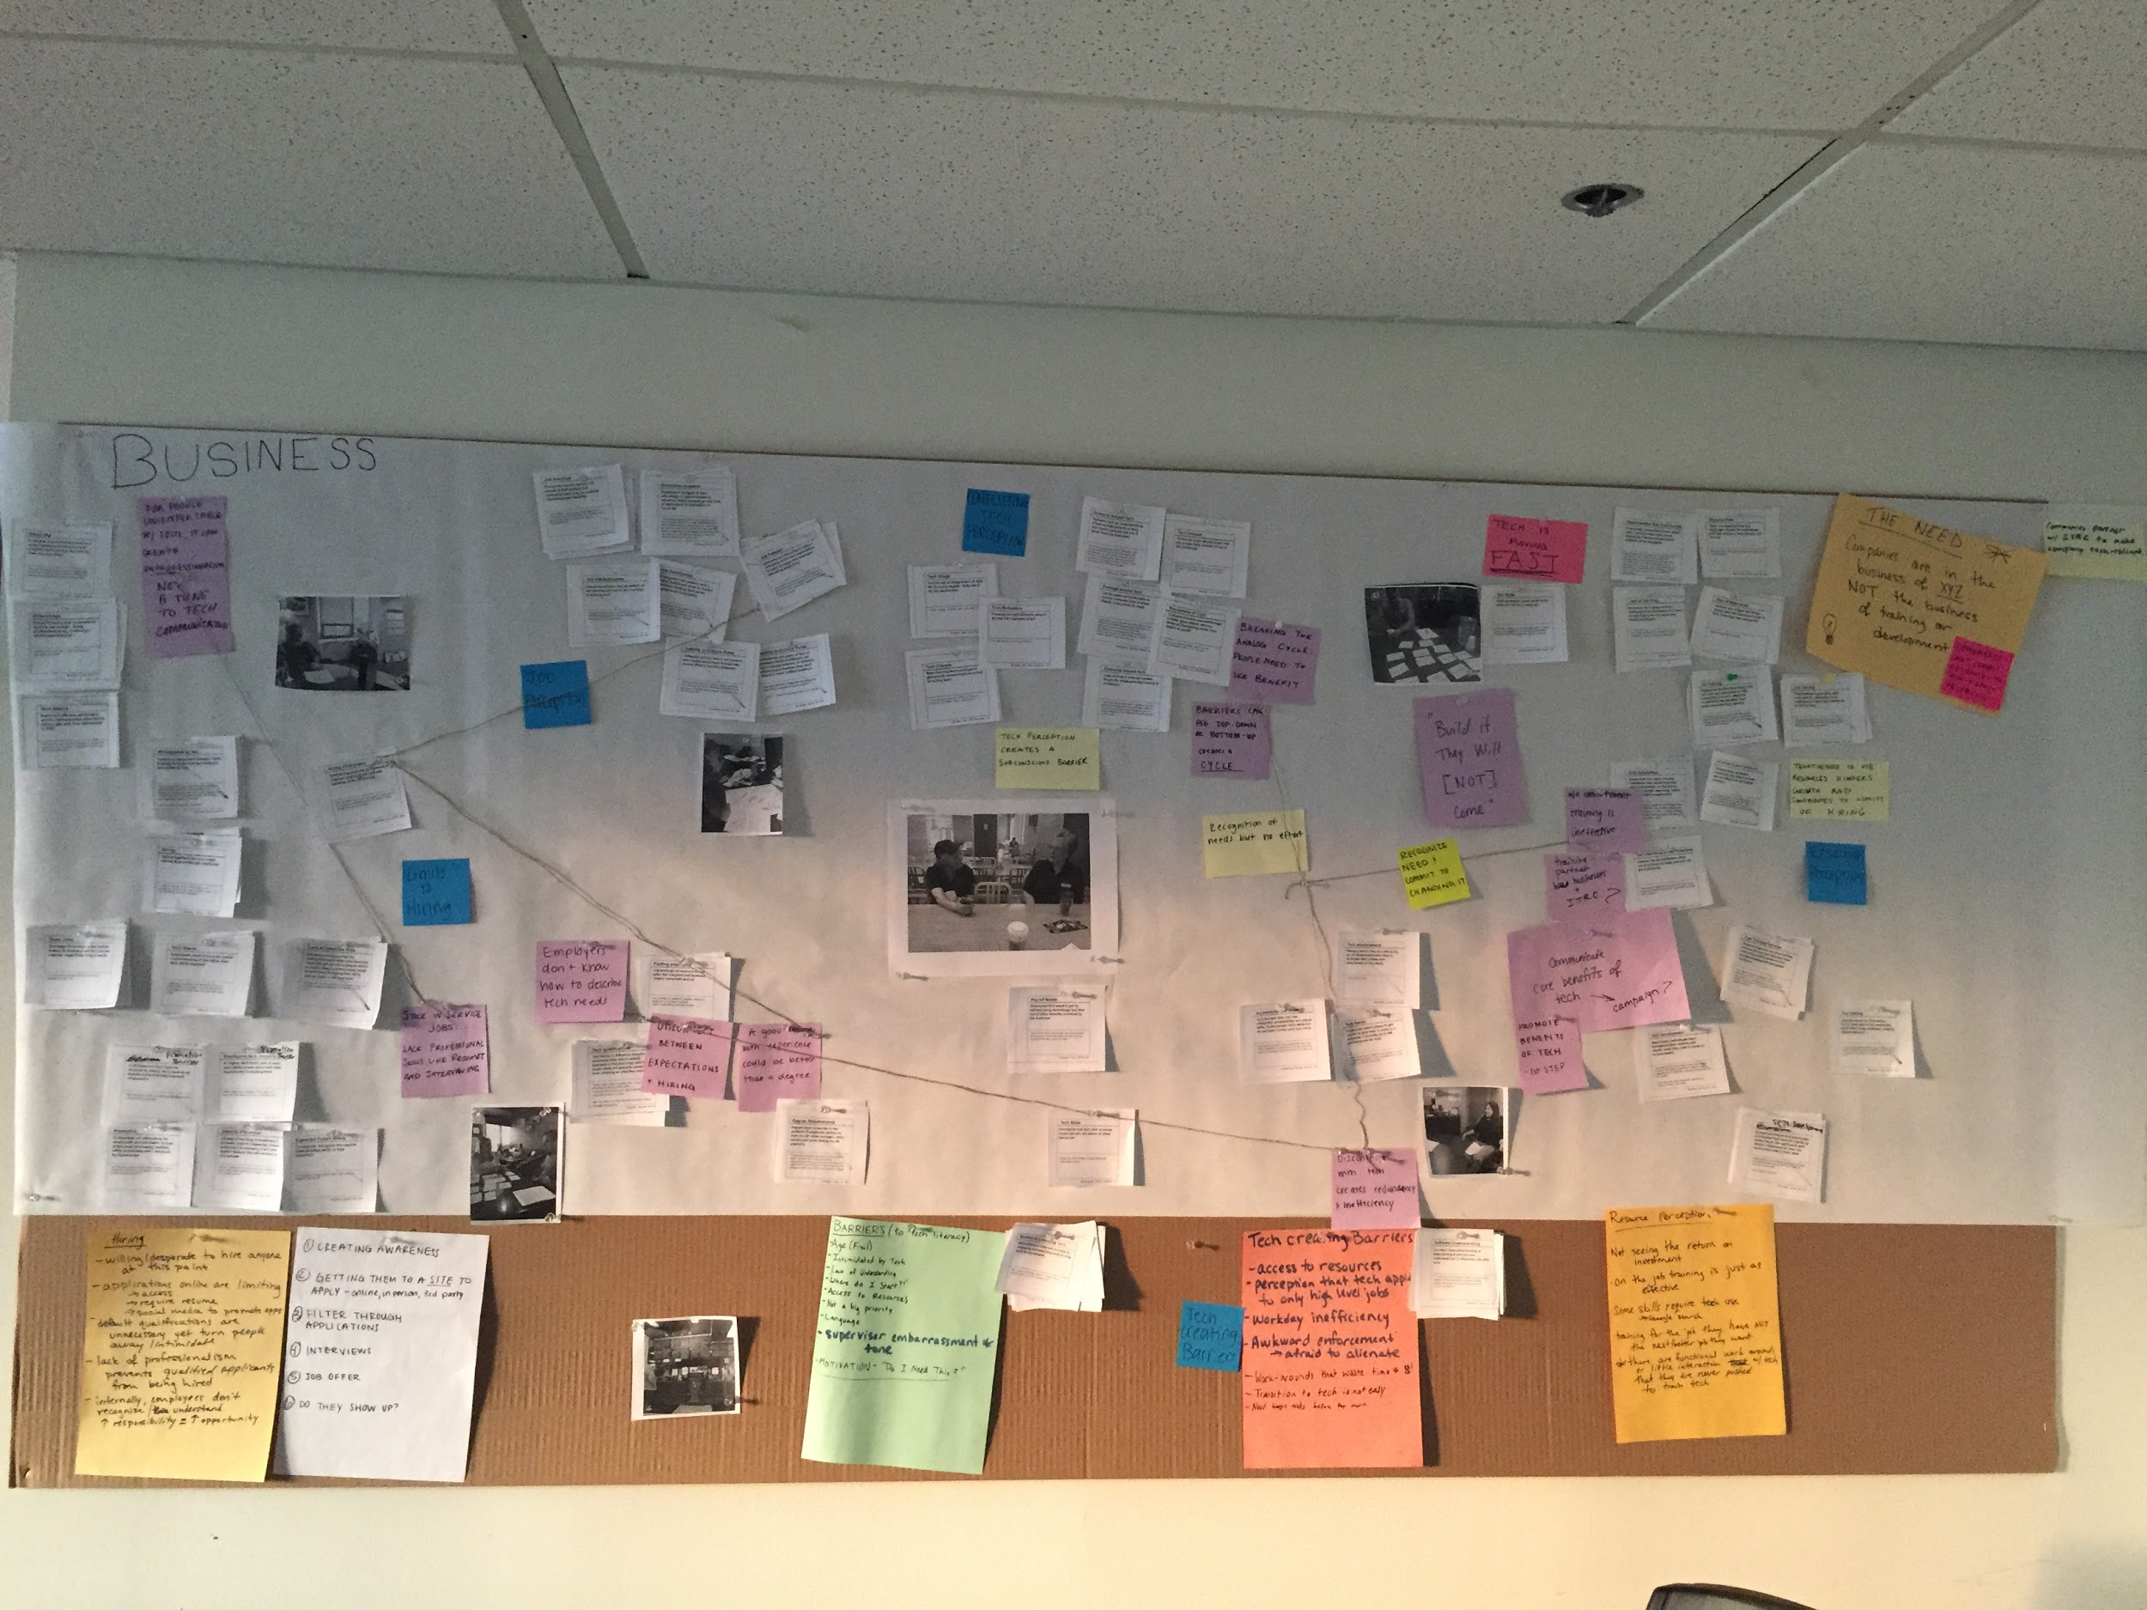
INSIGHT ORGANIZATION

Slide 12


IT CAN BE A STRUGGLE TO FIND CANDIDATES FOR A SENIOR LEVEL BECAUSE THEY LACK EFFECTIVE EMAIL COMMUNICATION SKILLS. IT’S AWKWARD TO BE HONEST AND SEPARATE TIME TO TEACH THEM.
VINCE, 45, LIPPERT COMPONENTS
Startup Stock Photos
Notes:
Erin

Slide 13
01
BUSINESS
Perception that if you’re not tech savvy, there’s a fundamental personality flaw
Tech can be threatening; need to hide if you feel less than tech savvy
“We usually just assume people know all of the basic tech skills ” - Patrick, 25
Fearful of appearing vulnerable, non tech savvy upper management set a tone of devaluing tech
Entry levels were going to supervisors for simple questions, but could have Google searched if tech tools were promoted
“I would like them to not be afraid of using the internet, but we get stuck in our world” - James, 40
“Management just ordered them laptops, they don't have a specific space, but they at least have a laptop” - Sandra, 35
Disconnects between management and employees often lead to technology breakdowns
“"We don’t tell them to [check their emails often] but if they can get into the HRS system we have emails for them" - Bonnie, 60
Supervisors promote a “if it ain’t broke, don’t fix it” mentality
“So this is bad. They are attached to those clipboards, which is a habit we are trying to break” - James, 40
IMPLICATION: Reframe the way tech averse managers perceive tech in the workplace

Slide 14

WE DO ON THE JOB TRAINING. IT’S NICE IF THEY HAVE EXPERIENCE BUT IT ALSO MEANS THEY HAVE HABITS THAT WE DO NOT LIKE.
JAMES, 40, SPI
South Bend Tribune
Notes:
Sam

Slide 15
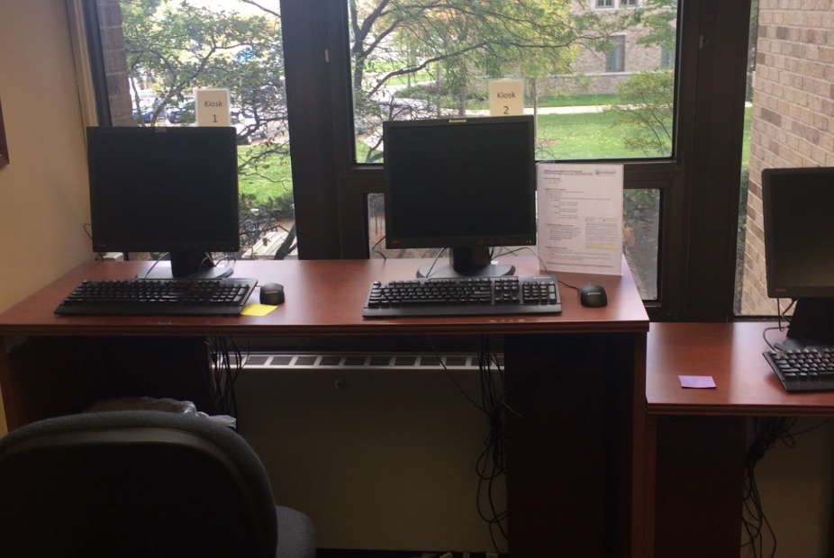
Notes:
This is their training

Slide 16
02
BUSINESS
Perception that offsite resources can’t offer what onsite training can
From experience, businesses no longer trust outside training resources credibility
“In 08/09, Indiana tried to handle this issue, but it wasn’t implemented well and employers looked at these
programs dubiously” – Vince, 45
Failing to see enough return on investment, employers stopped utilizing offsite resources
“There are 2 or 3 online plastics training offerings, but it was expense- about $30,000/year- and we didn’t feel
it was worth it” – James, 40
“They cancelled them, but I really loved the computer classes, I got to level 3!” – Kim, 36
Employers resort to “band-aid” fixes in daily work/ tech gaps because they feel entry levels don’t use enough tech for outside training offerings to address
“We don’t have a training center for our entry level employees, so we train on the job more informally during the day”
– Chad, 43
IMPLICATION: Promote tech training as a solution to workday inefficiency as firms are in the business of
XYZ, not the business of job tech training

Slide 17

THE YOUNGER GENERATION… THEY COULDN’T GET OFF WORK FOR A BIRTHDAY PARTY, SO THEY QUIT
BONNIE, 60, ELKHART PLASTICS
Instagram: West.SB
Notes:
Erin

Slide 18
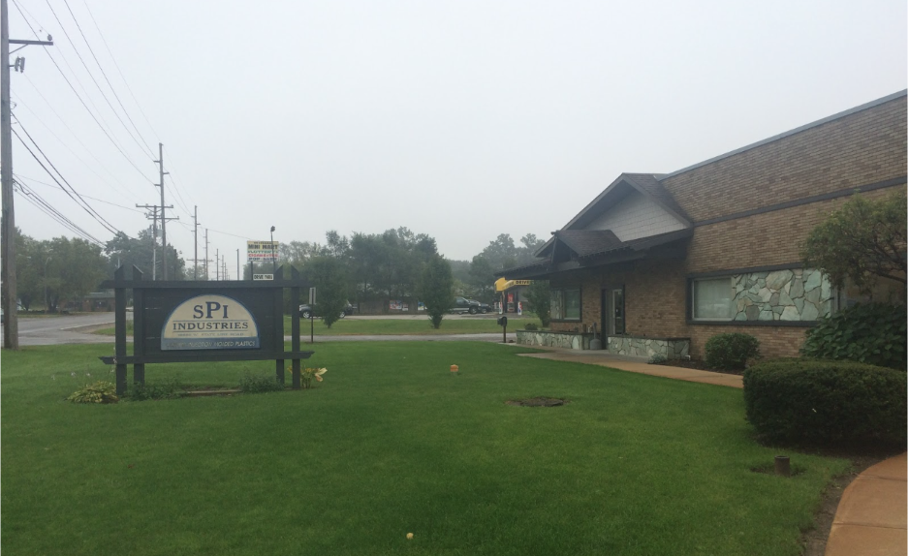
Notes:
Unexciting place to work, no passion, how can you be proud?

Slide 19
03
BUSINESS
Entry level positions are neglected and investment in the employee is insufficient
HR expects managers to know when employees are ready for promotion, yet their skills often go unnoticed
“We are hoping that it’s (internal promotion) happening at the manager level, but after an internal career fair
we found a few current employees that were way overqualified for their current job” – Lisa, 42
Lack of training opportunities and awareness around promotion
“We had partnered with an outside class before, but didn’t see much improvement, but I think if we were more serious
about it then it would have done more” – Sandra, 35
Employees struggle to take advantage of opportunities while employers assume lack of motivation
“I’m sending someone to Ivy Tech right now to do a work program… we pay for him to go and he’s just not
doing the work” - Bonnie, 60
“Internal promotion goes back to division of our more entry level positions who don’t think about asking for
opportunities. You have people in more professional roles who ask the important question” – Sandra, 35
There is little room for passion/pride for one’s job in a robotic work environment
“Our goal is consistency, having a process and doing it the same over and over again. That’s how we win the game”
– James, 40
IMPLICATION: Create an element of fulfillment by explaining job paths/promotion levels as
employees are hired
If employees are satisfied with the investment in their careers, there would be better
job performance

Slide 20
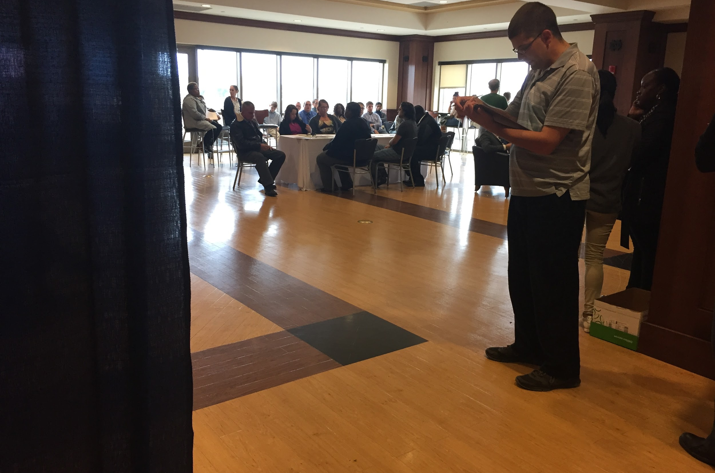
ONE OF THE HIRING CHALLENGES IS THAT WHEN WE EXTEND AN OFFER, THE APPLICANT NEEDS TO ELECTRONICALLY INITIATE PRE-EMPLOYMENT CHECKS
LISA, 42, ND FOOD SERVICE HR
Pexels

Slide 21

Notes:
Tech limits candidate pool bc applications are online

Slide 22
04
BUSINESS
Perception that in a non tech role, there are no tech needs
Entry level employees are not given proper tech access, so cannot fulfill new electronic expectations
“The University as a whole is directing communication electronically, but our department is not in front of
computers often and we have to reset their net IDs to reactivate their emails” – Lisa, 42
Tech discomfort creates a general unprofessionalism that prevents entry levels from being promoted
“Not knowing how to create a good resume is the biggest thing we see and that precludes them from even getting an
interview” – Vince, 45
There is a desire to teach tech to enhance employees’ skills, but are unable to define needs/ logistics
“A lot of our workforce has never needed to use much tech, so we don’t know how to give them tech basics that would
apply to what they do” – Matthew, 40
Companies lack power to enforce tech for fear of losing employees who are resistant to implementation
“"We have one guy who's been here for a long, long time and he's the customer service/purchasing order guy and he's
probably one of the most stubborn when it comes to letting go of the paper, but we need him" – James, 40
IMPLICATION: Introduce platforms that employers can use to appropriately and comfortably enforce tech
in any industry
Enhance employee’s personal development by increasing confidence in tech
Notes:
employees do not have access to tech to fulfill what is expected.
Lack of tech needs creates a lack of professionalism to advance
The task of educating all employees on tech is daunting
Companies have trouble “forcing” employees to change

Slide 23

YEAH WE COULD BE MORE SPECIFIC, WE DON’T NEED ALL OF THESE SKILLS FOR THAT ROLE. WE NEED TO IMPROVE THE LANGUAGE.
PATRICK, 25, ENFOCUS
Notes:
Sam

Slide 24
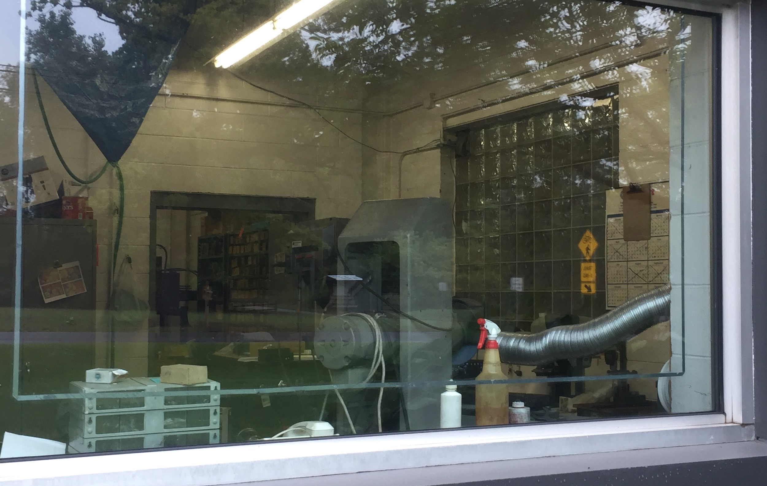
Notes:
Chaotic workplace, cleaning supplies and paper and open boxes in the workspace

Slide 25
05
BUSINESS
Perceptions create a disconnect between actual job needs and expected needs
Vague understanding of tech prevents employers from attracting potential employees
“"A college degree is not required for most of these positions, they just need the skillset"” – James, 40
Utilizing third party digital platforms limits the candidate pool
“We have job postings on Facebook, LinkedIn, and Craigslist” – Michael, 31
“I have no concept of how many people in this community we’re having trouble reaching because they can’t
complete the online application” – Matthew, 40
Defaults have become overused where they no longer even relate to desired skills
When looking over the application qualifications, James face was shocked by what he was reading and was
followed by “wow we need to update this”
The employers we spoke with did not have consistent means to accurately define tech needs/literacy
The hiring process hinders fulfillment of employment needs for both job seekers and providers
“I don’t know what I’m looking for, I guess any service job, a register maybe” – John, 47
“At this point, we’ll hire off the street and train them on the job” – Bonnie, 60
IMPLICATION: Create a space for job providers to define actual needs and for job seekers to
explore interests and abilities to form employment matches

Slide 26

Notes:
merging the job seeker to the job provider

